Slide 1
SMART LIGHT HACK USING RASPBERRY PI AND NODEMCU
Supervised by
Dr. Ashish Kumar Dwivedi
The LNM Institute of Information Technology
Shivam Maheshwari 22mcs002
Shivangee Singh 22mcs003

Slide 2
Presentation Outline
What is IoT Security?
Problem with Iot Devices
IoT Security Project
Component Needed
Level-1 Hack
Level-2 Hack
Level-3 Hack
Final Patch
References

Slide 3
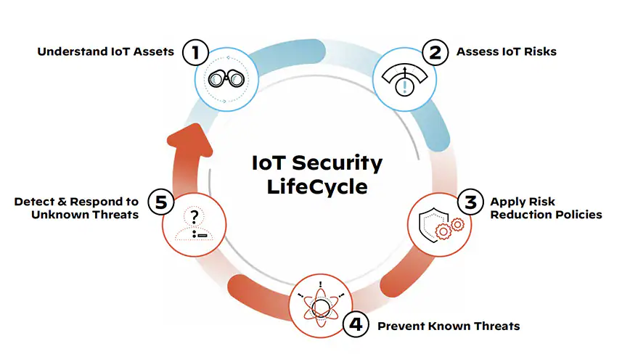
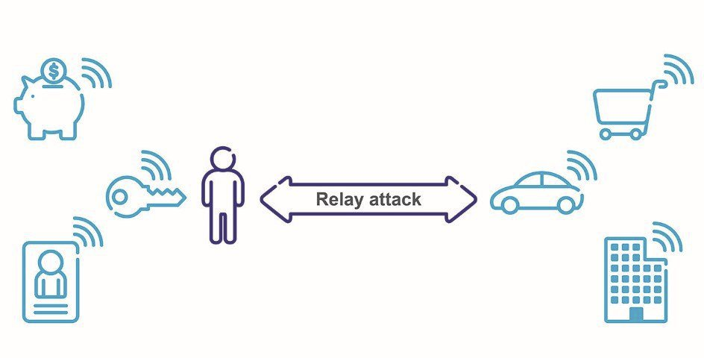
IoT Security
IoT security is the area of endeavor concerned with safeguarding connected devices and networks in the Internet of things.
The Internet of Things involves the increasing prevalence of objects and entities – known, in this context as things — provided with unique identifiers and the ability to automatically transfer data over a network. Much of the increase in IoT communication comes from computing devices and embedded sensor systems used in industrial machine-to-machine (M2M) communication, smart energy grids, home and building automation, vehicle to vehicle communication and wearable computing devices.

Slide 4
Problem with Iot Devices
The main problem is that because the idea of networking appliances and other objects is relatively new, security has not always been considered in product design. IoT products are often sold with old and unpatched embedded operating systems and software. Furthermore, purchasers often fail to change the default passwords on smart devices — or if they do change them, fail to select sufficiently strong passwords. To improve security, an IoT device that needs to be directly accessible over the Internet, should be segmented into its own network and have network access restricted. The network segment should then be monitored to identify potential anomalous traffic, and action should be taken if there is a problem.
Security experts have warned of the potential risk of large numbers of unsecured devices connecting to the Internet since the IoT concept was first proposed in the late 1990s. In December of 2013, a researcher at Proofpoint, an enterprise security firm, discovered the first IoT botnet. According to Proofpoint, more than 25 percent of the botnet was made up of devices other than computers, including smart TVs, baby monitors and other household appliances.

Slide 5
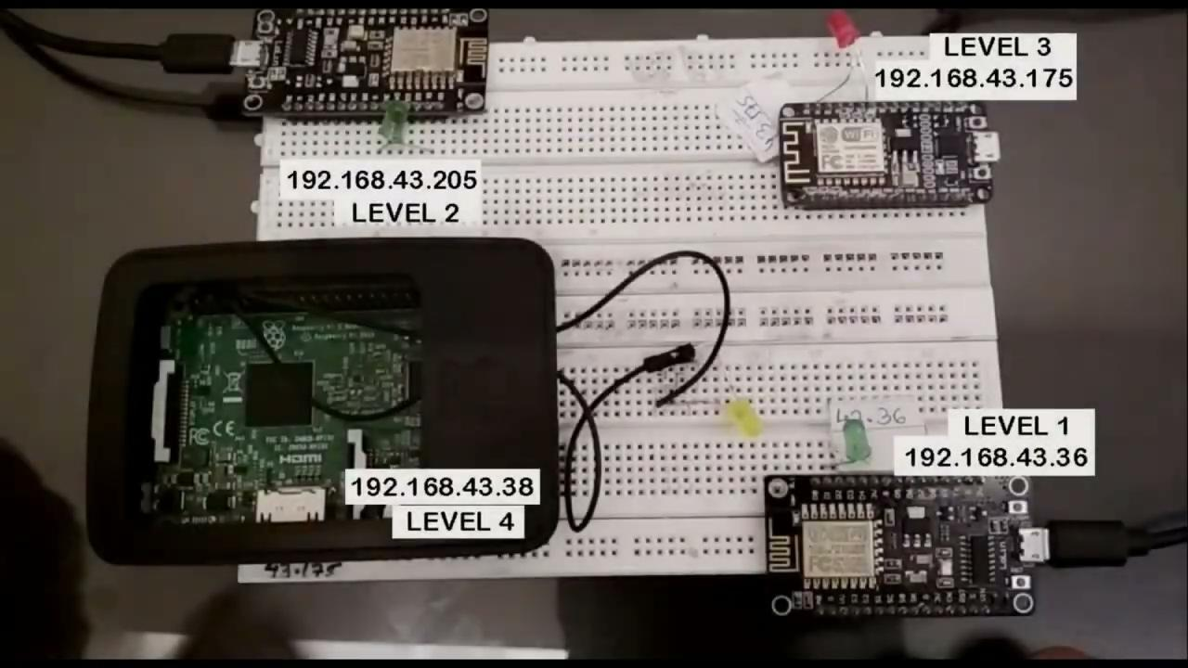
IOT Security Project :
Video below shows demo of IOT devices different types of Hacks and a final patch to secure IOT devices here Smart light is used to showcase the Attack &amp; Patch.
Check out our video, code below follows the video to help:

Slide 6
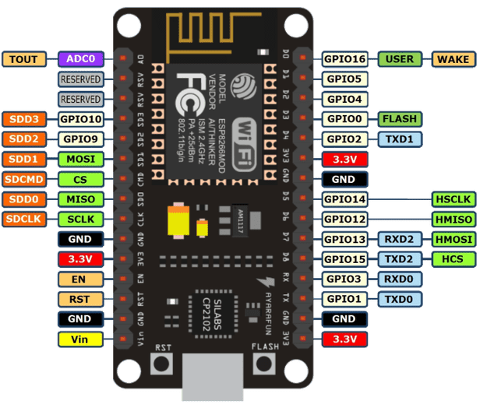
Component Needed:
Hardware:
NodeMCU ESp8266 WiFi development Board
RASPBERRY PI 3B
Led’s
Breadboard
Connecting Wires
Software:
Arduino IDE
Kali Linux
Ubuntu

Slide 7
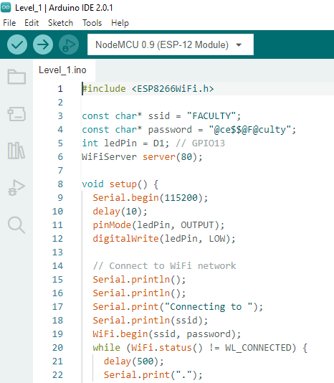
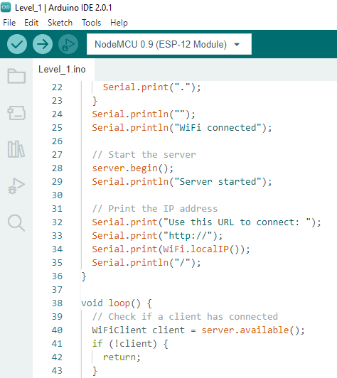
Level 1 Hack :
Level 1 device just uses get operation to control the led and can be easily hacked by extracting out the Get headers using tcpdump &amp; netcat tool.

Slide 8
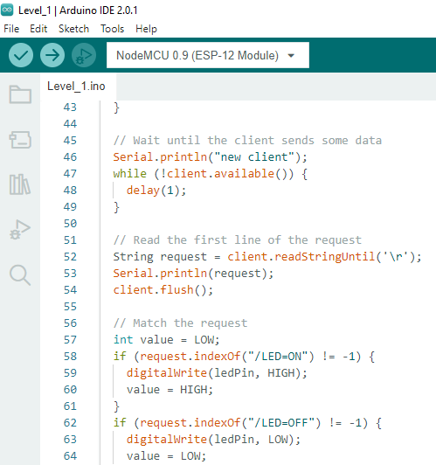
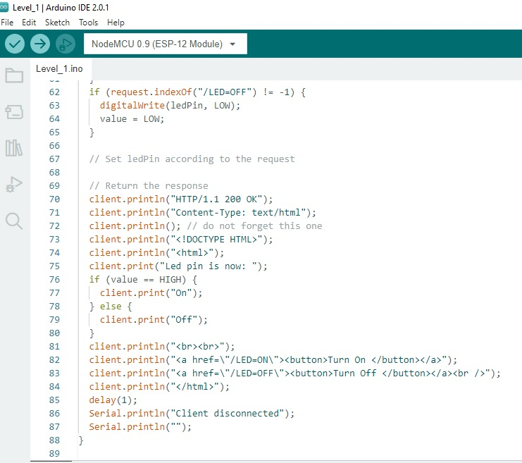
Level 1 Hack :
Level-1 Code available on this link: https://drive.google.com/file/d/1pl1lPMWEClW9w4bsEfjHuh_LXQoQYiyC/view?usp=sharing

Slide 9
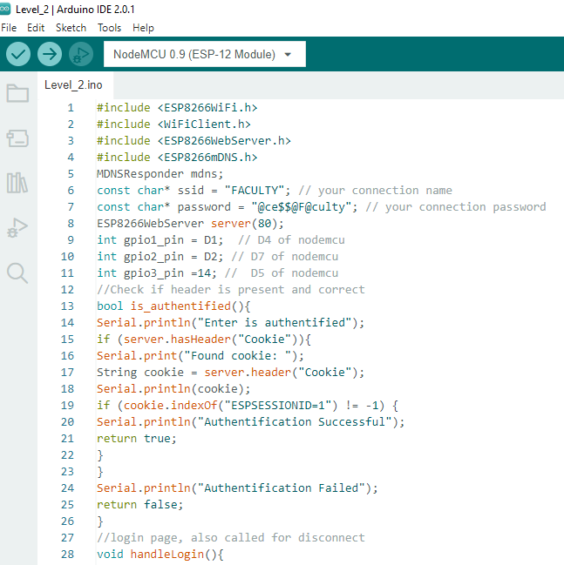
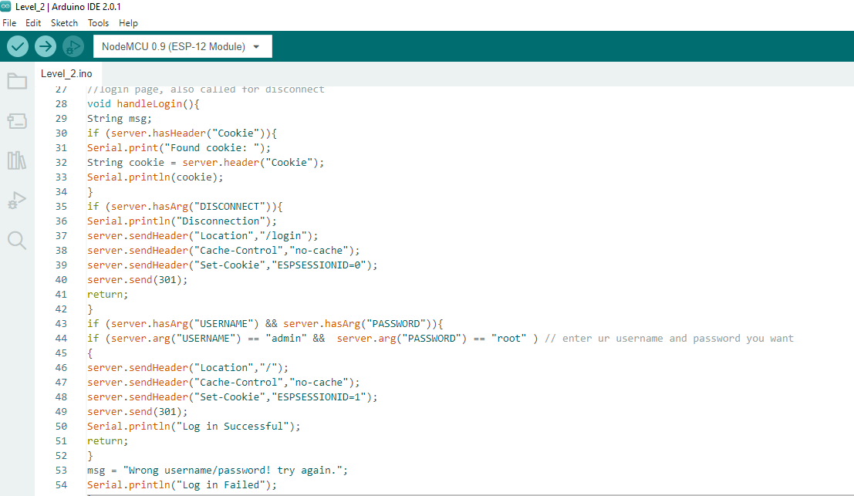
Level 2 Hack :
Level 2 Hack :
In level 2 we increase the security level little bit by authenticating the user, using a login which uses POST operation. but attacker will use wireshark and capture the typed user credentials.

Slide 10
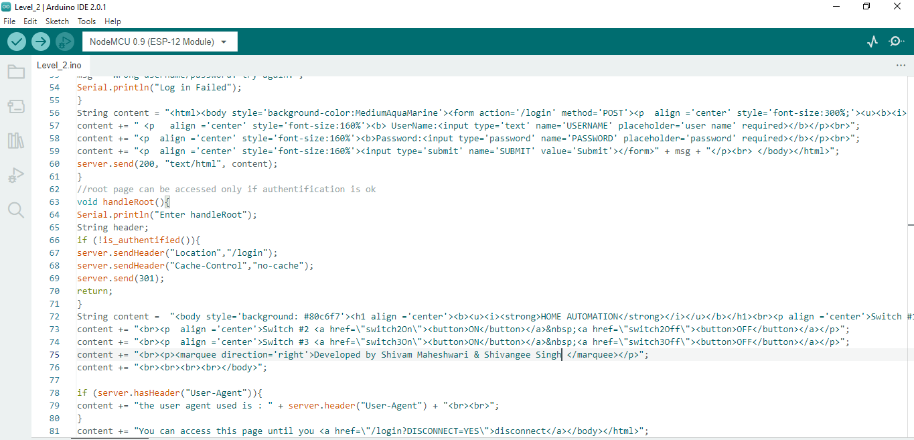
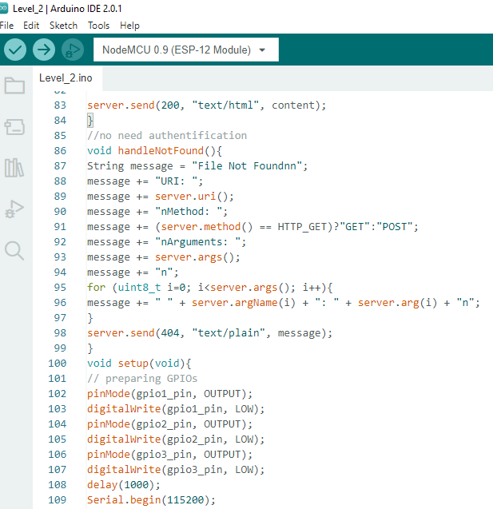
Level 2 Hack :
Level-2 Code available on this link: https://drive.google.com/file/d/1AN2e96kRpkFDj25PUQdyp6ZdkMNxqUwq/view?usp=sharing

Slide 11
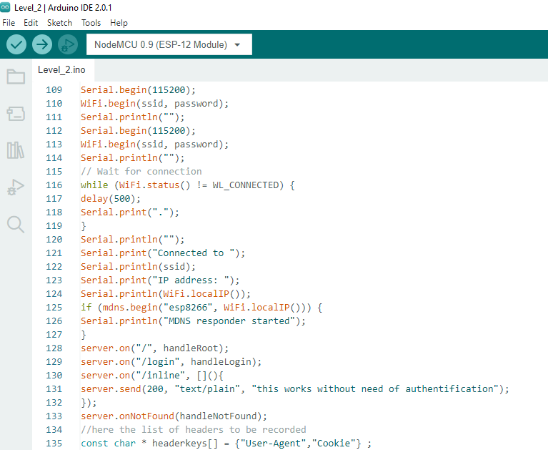
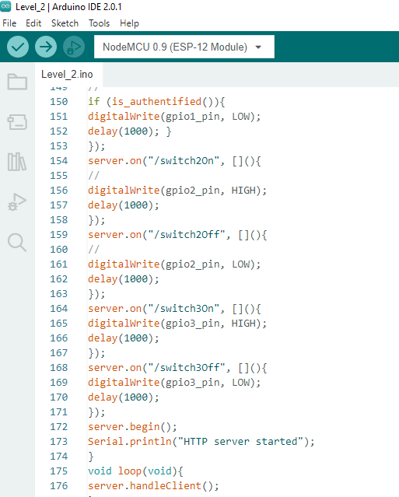
Level 2 Hack :

Slide 12
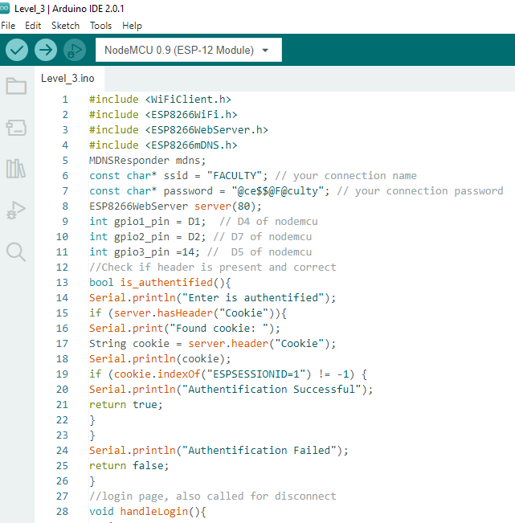
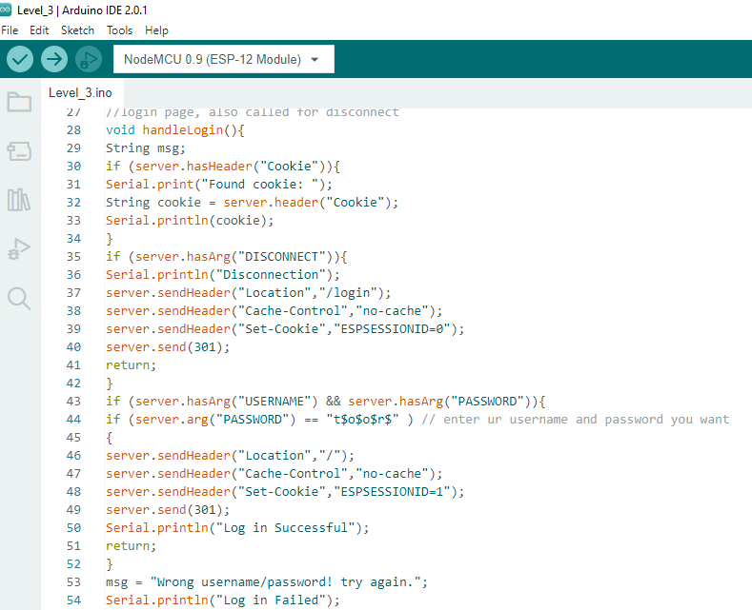
Level 3 Hack :
In level 3 we will increase security level by using encryption technique here we will encrypt user credentials so that attacker will not able to use user credentials. But here attacker will use Fiddler tool used for packet capturing and have the capability of replaying the captured packet, here attacker will replay the packet which is used for control the smart led.

Slide 13
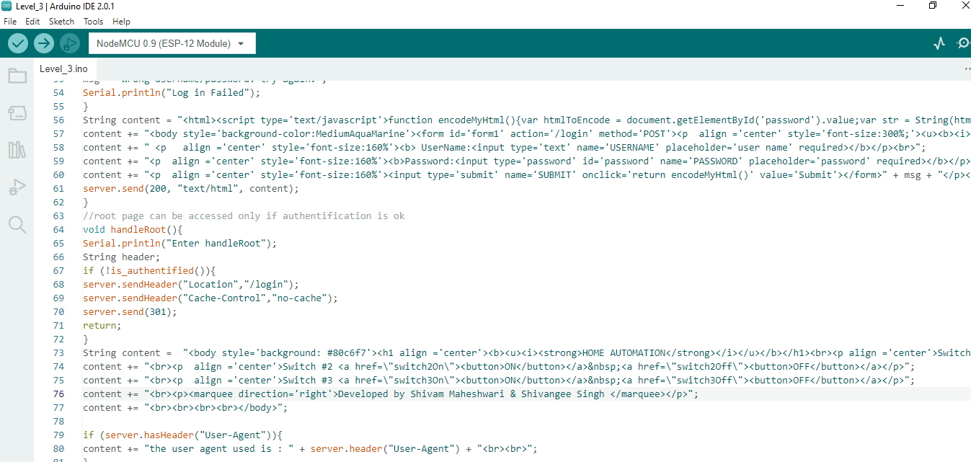
Level 3 Hack :
Level-3 Code available on this link:
https://drive.google.com/file/d/17qx0EBzGstxLD--yROgBg20BXPwNFz7r/view?usp=sharing

Slide 14
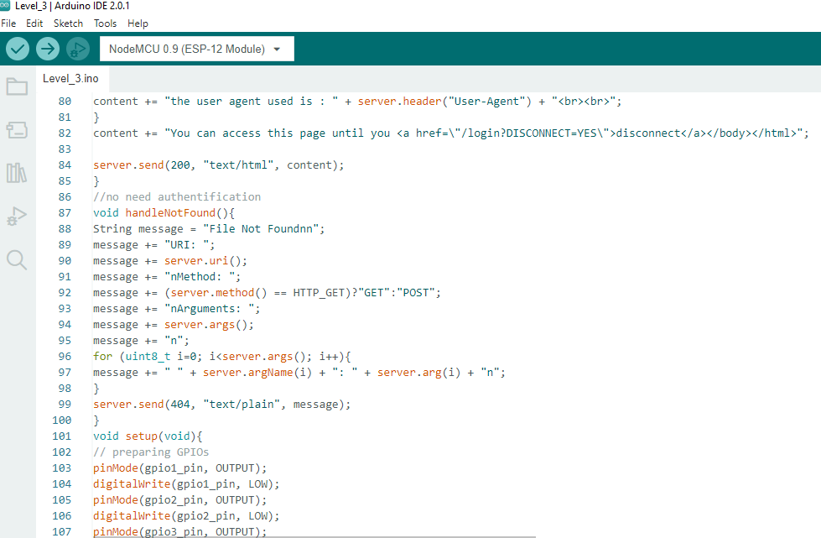
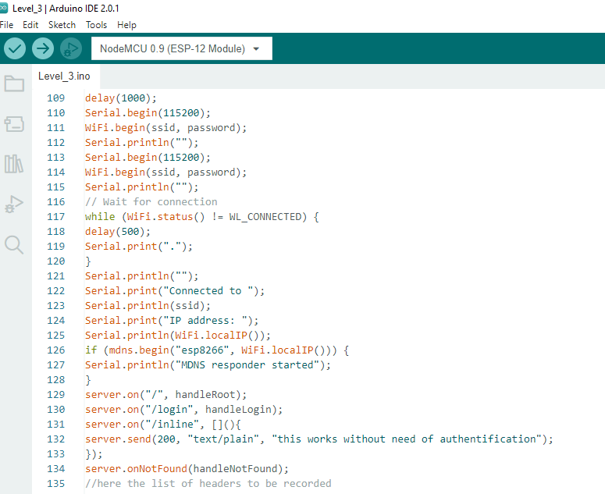
Level 3 Hack :

Slide 15
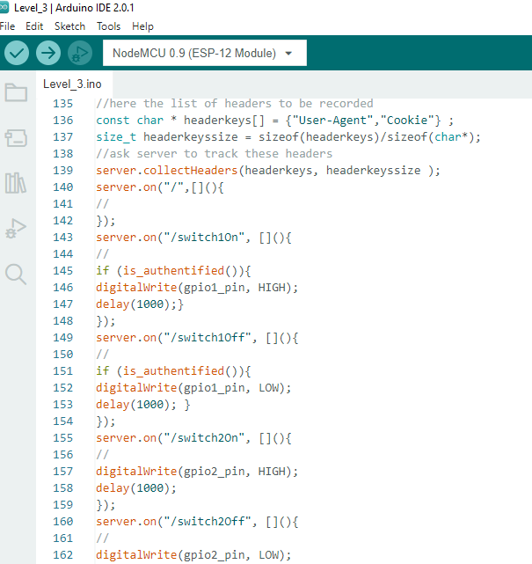
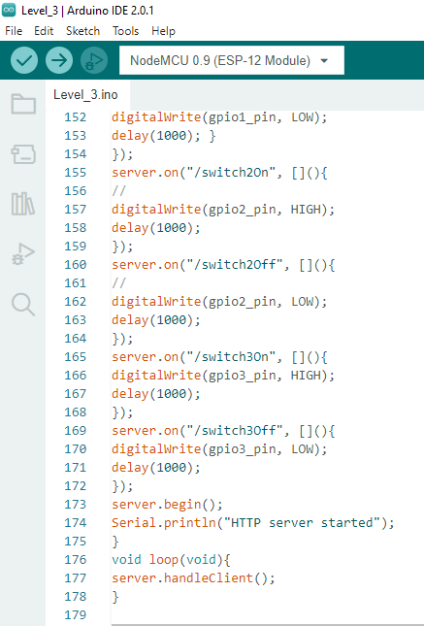
Level 3 Hack :

Slide 16
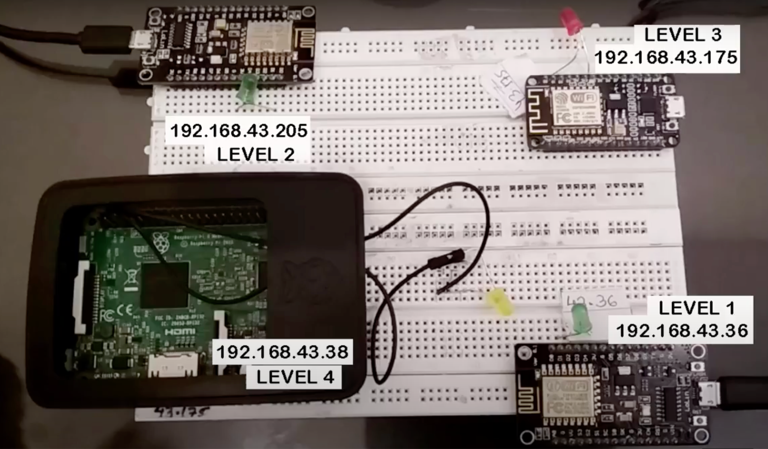
Final Patch :
In final patch we will use access token along with encrypted user credentials so will not able do any type of attack rather it be packet capturing, packet replay – because replay packet token will not match &amp; packet get refused.
Final Patch Code available on this link: https://drive.google.com/drive/folders/10exCnZuEf5eA3C1o4MPHazObJ2txxe0t?usp=sharing

Slide 17
References
https://www.paloaltonetworks.com/cyberpedia/what-is-iot-security
https://www.rapyder.com/blogs/top-10-iot-security-solutions-for-common-iot-security-issues/
https://www.thalesgroup.com/en/markets/digital-identity-and-security/iot/iot-security
https://www.techtarget.com/iotagenda/definition/IoT-security-Internet-of-Things-security

Slide 18
Thank you
Have a Nice Day !

